Slide 1
SDLC: Software Development Life Cycle.

Slide 2
Agenda:
What is SDLC?
What are the phases of SDLC?
What are the different models in SDLC?

Slide 3
SDLC: An Overview.

Slide 4

SDLC – An Overview:
Software development life cycle (SDLC) is a structured process that is used to design, develop, and test good-quality software.
SDLC consists of a precise plan that describes how to develop, maintain, replace, and enhance specific software.
The life cycle defines a method for improving the quality of software and the all-around development process.

Slide 5
Phases of SDLC

Slide 6
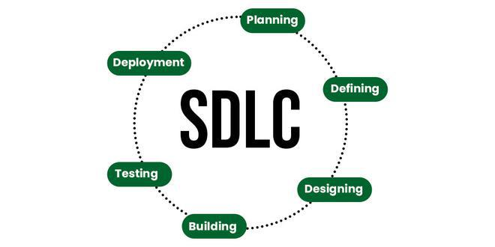
Phases of SDLC:
The most rudimentary steps of a software lifecycle process consists of:
• Requirement Analysis.
• Defining.
• Designing.
• Coding.
• Testing.
• Deployment.
• Maintenance.

Slide 7

Phases of SDLC:
Requirement Analysis:
• Planning is a crucial step in everything, just as in software development.
• Senior members of the team perform it with the inputs from all stakeholders and domain experts or SMEs in the industry.
• Includes the approximate cost and time estimated for final delivery, currency of exchange, how the project will be developed etc.

Slide 8
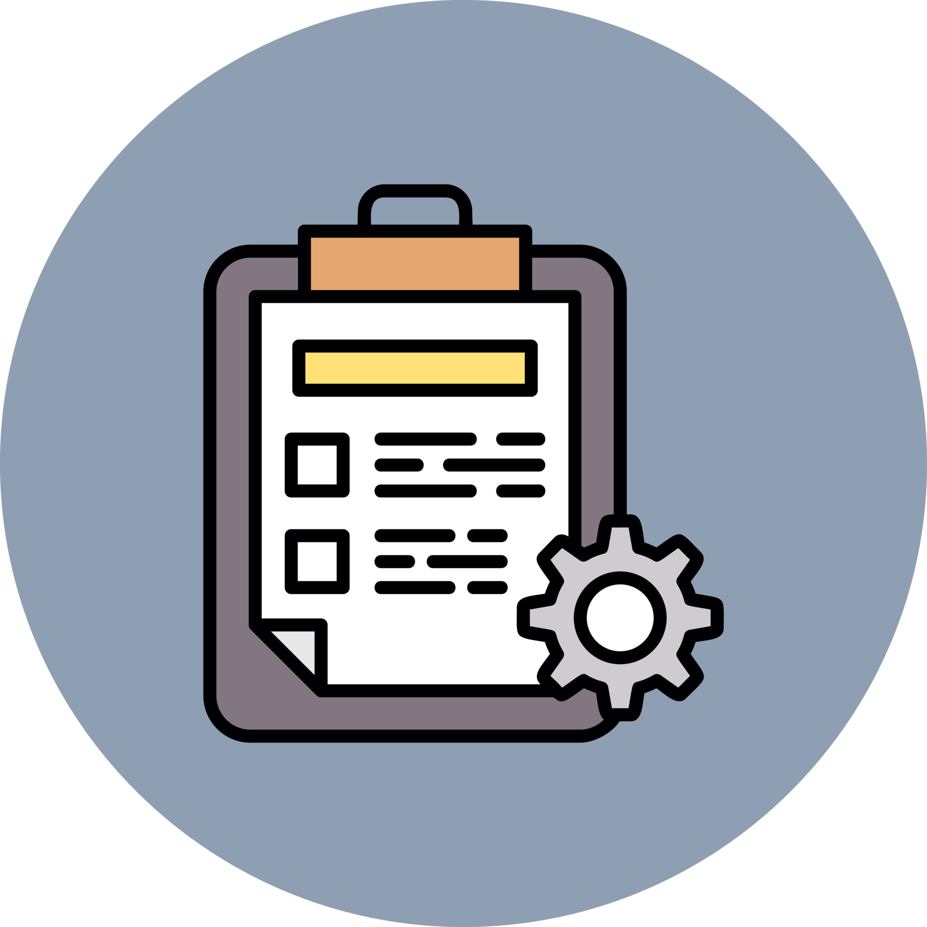
Phases of SDLC:
Defining The Requirements:
• Includes documentations of the requirements and needs approvals of all the stakeholders.
• This is done via SRS - Software Requirement Specification document which contains all the project requirements to be constructed and developed during the project life cycle.

Slide 9
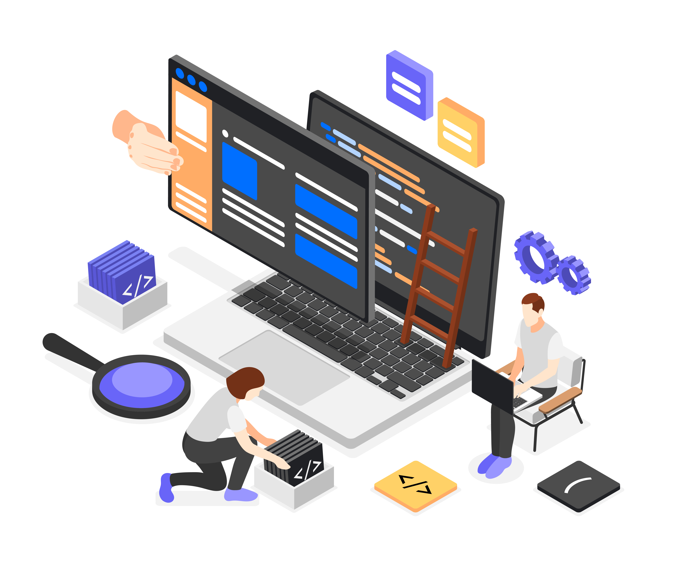
Phases of SDLC:
Designing The Software:
• SRS is a reference for software designers to come up with the best architecture for the software.
• Multiple designs for the product architecture are present in the Design Document Specification (DDS).
• After evaluating all the possible factors, the most practical and logical design is chosen for development.

Slide 10
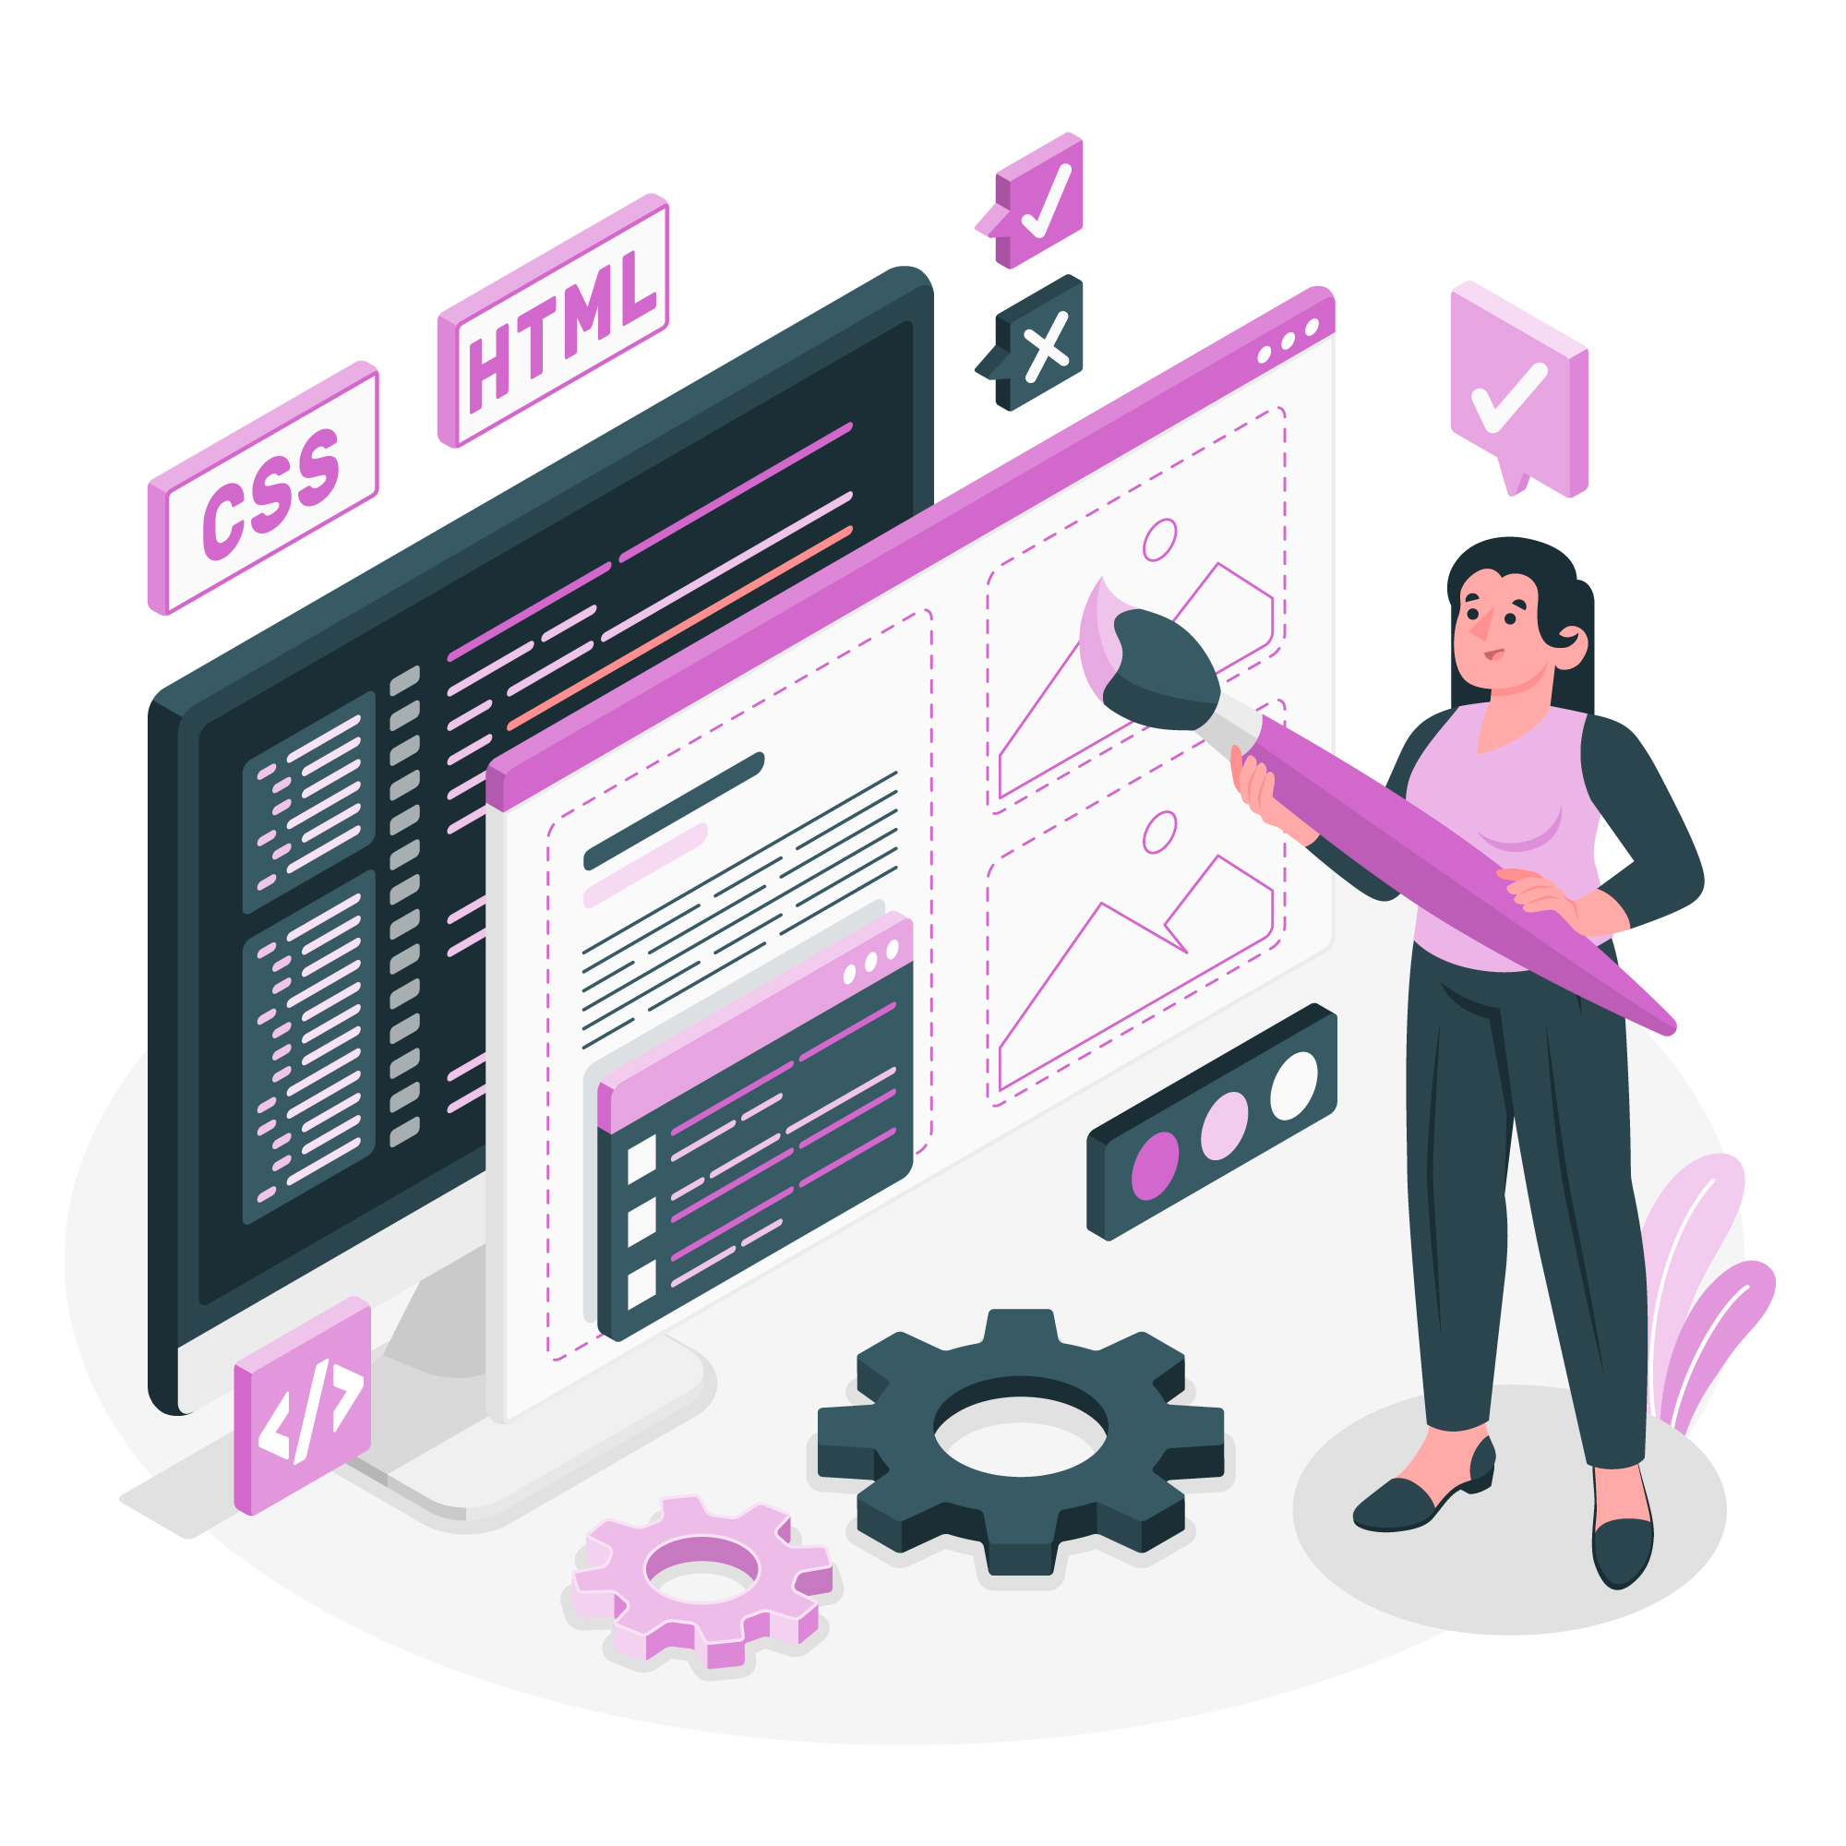
Phases of SDLC:
Developing The Project:
• Developers use a specific programming code as per the design in the DDS. Hence, it is important for the coders to follow the protocols set by the association.
• Conventional programming tools like compilers, interpreters, debuggers, etc. are also put into use at this stage.

Slide 11
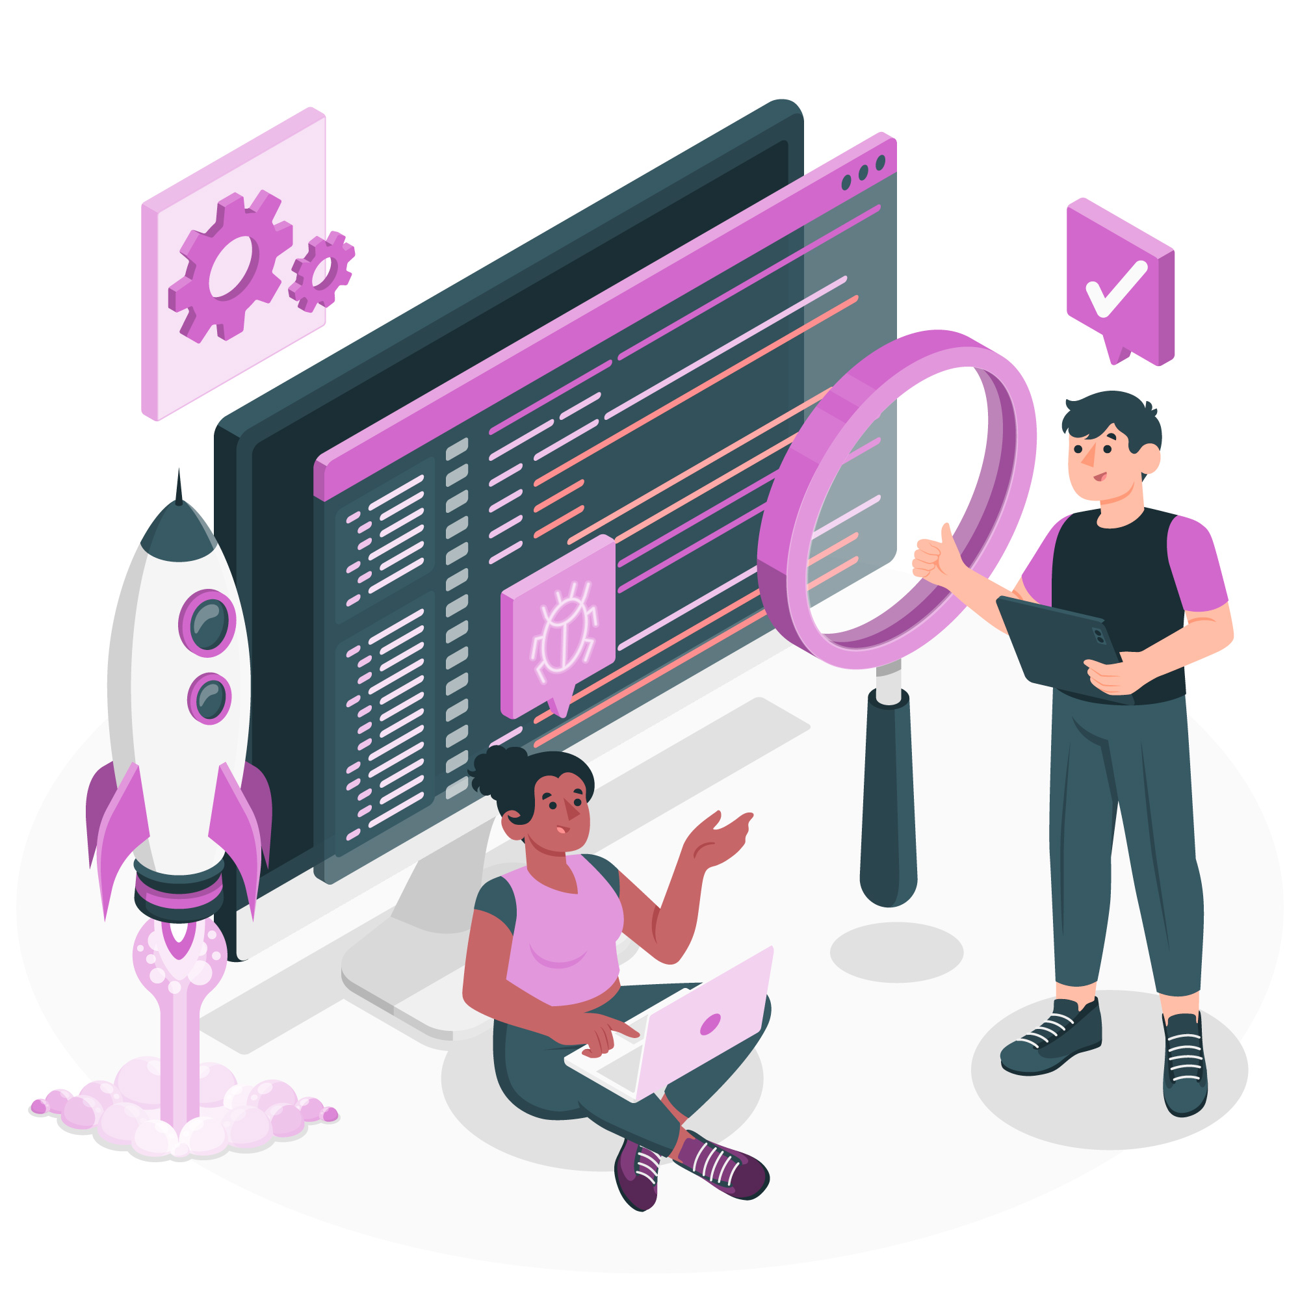
Phases of SDLC:
Testing The Software:
• Testing of the software is necessary to ensure its smooth execution and to check for code quality.
• At this stage, all the probable flaws are tracked, fixed, and retested. This ensures that the product confronts the quality requirements of SRS.

Slide 12

Phases of SDLC:
Deployment of The Software:
• The conclusive product is released in phases as per the organization’s strategy.
• Then it is tested in a real industrial environment.
• After retrieving beneficial feedback, the company releases it as it is or with auxiliary improvements to make it further helpful for the clients.

Slide 13
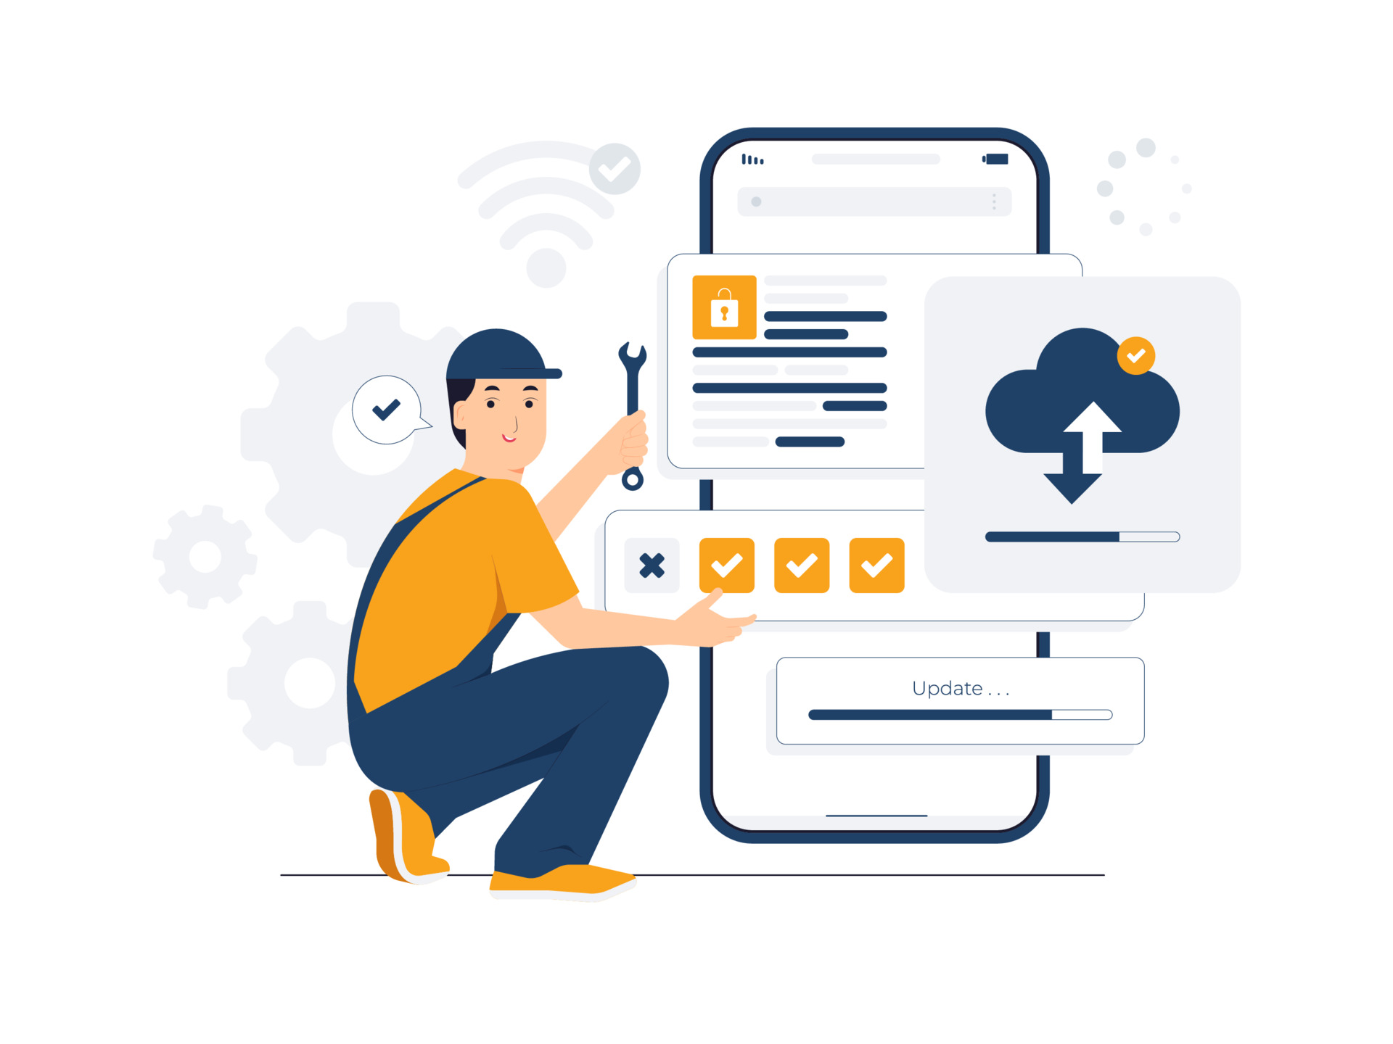
Phases of SDLC:
Maintenance of The Software:
• Essential component that ensures continued software functionality, handles vital repairs and updates, and ensures that the software remains relevant and usable.
• Maintenance phase ensures that our software doesn't just reach completion, but it continues to function effectively and evolve according to user needs and technological advancements over time.

Slide 14
Various Models in SDLC.

Slide 15
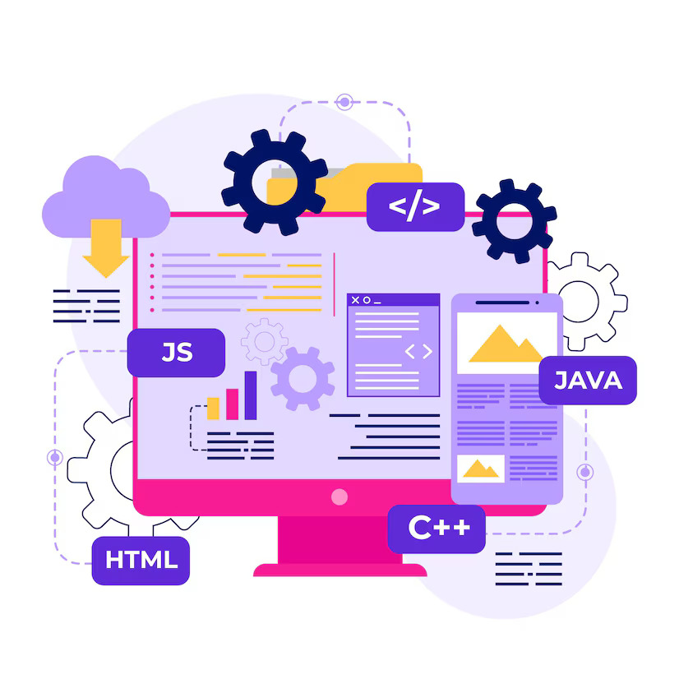
Various Models in SDLC:
The most prominently used models of SDLC are listed below:
• Waterfall Model.
• RAD Model.
• Spiral Model.
• V-Model.
• Incremental Model.
• Agile Model.
• Iterative Model.
• Big-Bang Model.

Slide 16
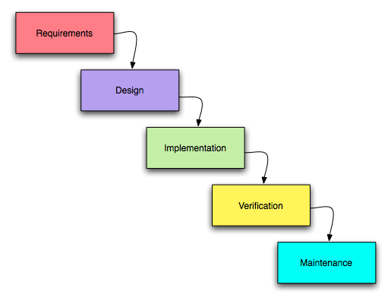
Waterfall Model:
• It is the fundamental model of the software development life cycle. This is a very simple model.
• Because of its simple structure, the waterfall model is easier to use and provides a tangible output.
• Once a phase seems to be completed, it cannot be changed, and due to this less flexible nature, the waterfall model is not recommended for large scale projects.

Slide 17
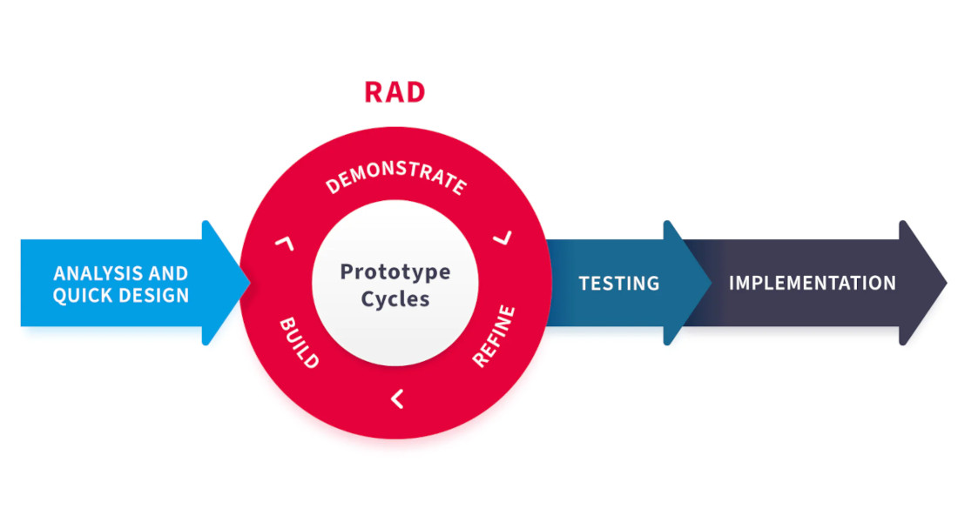
RAD Model:
• Rapid Application Development model is a type of software development methodology that emphasizes quick and iterative release cycles.
• RAD is designed to be more flexible and responsive to user feedback and changing requirements throughout the development process.
• A software project can be implemented using this model if the project can be broken down into small modules wherein each module can be assigned independently to separate teams.

Slide 18
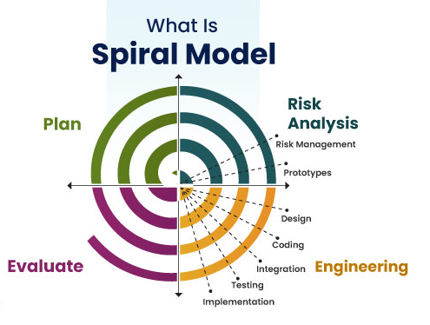
Spiral Model:
• The spiral model in SDLC is one of the most crucial SDLC models that provides support for risk handling.
• It has various spirals in its diagrammatic representation; the number of spirals depends upon the type of project.
• Each loop in the spiral structure indicates the Phases of the Spiral model.

Slide 19
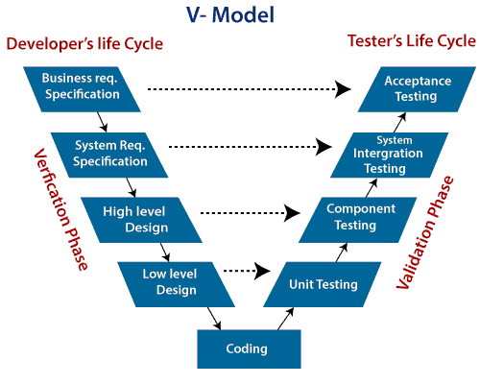
V-Model:
• The V-shaped model in SDLC is executed in a sequential manner in V-shape.
• Each stage or phase of this model is integrated with a testing phase.
• It is also known as the verification or validation model.

Slide 20
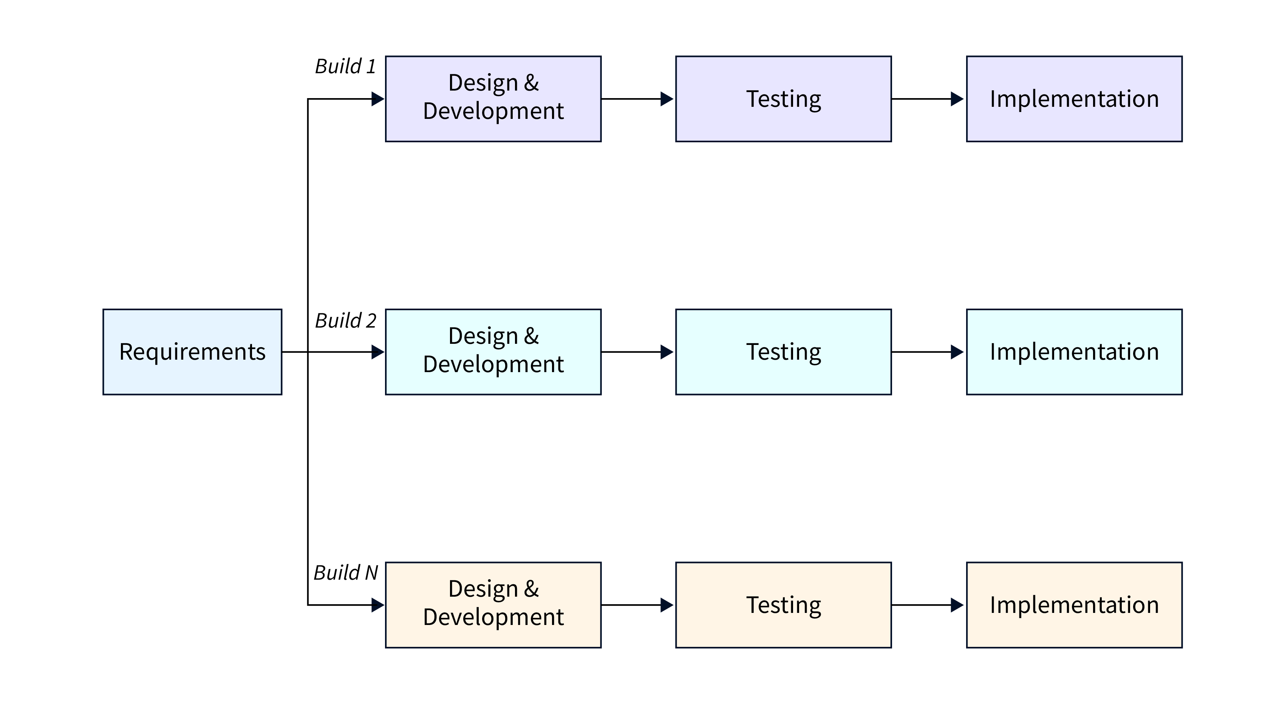
Incremental Model:
• The Incremental Process Model is also known as the Successive version model.
• First, a simple working system implementing only a few basic features is built and then that is delivered to the customer.
• Then thereafter many successive iterations/ versions are implemented and delivered to the customer until the desired system is released.

Slide 21
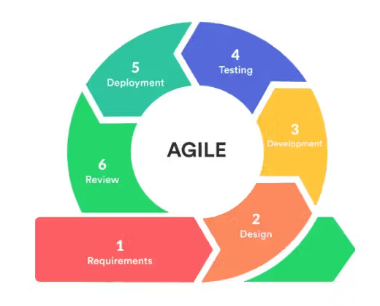
Agile Model:
• The Agile Model was primarily designed to help a project adapt quickly to change requests.
• Agility is achieved by fitting the process to the project and removing activities that may not be essential for a specific project.
• Provides constant support till the fulfilment of the client requirement.

Slide 22
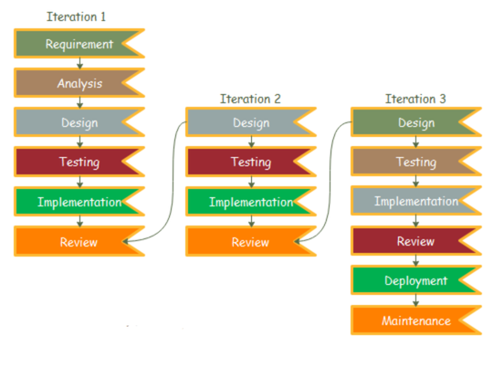
Iterative Model:
• Iterative development involves repeating the development cycle multiple times, with each iteration adding new features or refining existing ones.
• Each iteration builds upon the previous one, incorporating feedback and changes to improve the software.
• This approach allows for flexibility and adaptability, as requirements can evolve over time.

Slide 23
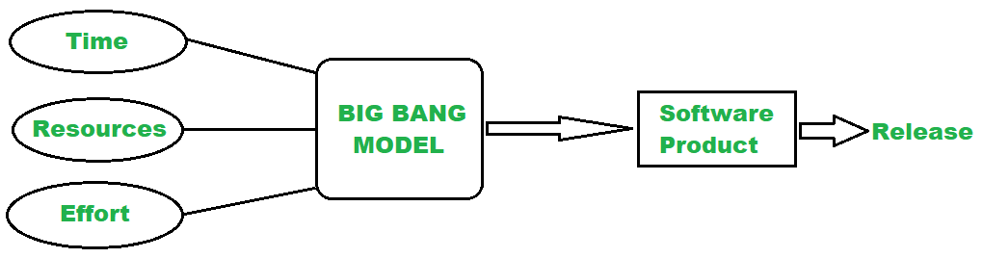
Big - Bang Model:
• The Big bang model is an SDLC model that starts from nothing. It is the simplest model in SDLC as it requires almost no planning.
• This SDLC model combines time, efforts, and resources to build a product.
• The product is gradually built as the requirements from the customer come.

Slide 24
References:
• Software Development Life Cycle (SDLC)
• Iterative Incremental Model
• Agile Development Models
• Rapid Application Development Model
• Overview of Big Bang Model
• Spiral Model

Slide 25
Thank You!
- Nisanth Saravanan.

